Slide 1
Using Generative Adversarial Network to Generate Synthetic Population
Yijun Wei¹
Luca Sartore¹
Nell Sedransk¹

Slide 2
Disclaimer
The findings and conclusions in this presentation are those of the authors and should not be construed to represent any official USDA, or U.S. Government determination or policy
This research was supported in part by the intramural research program of the U.S. Department of Agriculture, National Agricultural Statistics Service

Slide 3
Outline
Background - Census of Agriculture
Goal of the research
Approach: Generative Adversarial Network (GAN)
Experiment and result
Conclusion and future work

Slide 4
Census of Agriculture
Every five years, USDA’s National Agricultural Statistics Service (NASS) conducts the U.S. Census of Agriculture
The Census provides a detailed picture of U.S. farms, ranches and the people who operate them
It is the only source of uniform, comprehensive agricultural data for every state and county in the United States
NASS makes Census data publicly available only as summary statistics
Record-level information should be provided and disclosure of the confidential information should be averted

Slide 5
Goal of the research
Problem: To provide detailed information based on the Census data
Constraint: To avoid the disclosure of the confidential information
Solution: A modified or synthetic dataset that preserves the internal relationship of the original dataset
Previous approaches (Rubin, 1993; Reiter, 2005a,b,c; Paiva et al., 2014; Drechsler and Reiter, 2009):
Synthetic data distributions generated from models
Pooled or near-neighbors, used as exchangeable observations
Inter-changes of data elements among units
The trade-off for synthetic data is disclosure protection vs preservation of data complexity

Slide 6
Motivation of Generative Adversarial Network (GAN)
Idea:
To preserve finer internal structures
To duplicate statistical properties with the original dataset
Approach:
To use deep learning networks to synthesize
To revise until synthetic data cannot be distinguished from the original data
Solution: Pair of networks
Generative network (G-network) creates record-level synthetic data
Discriminative network (D-network) distinguishes real data from the synthetic

Slide 7
Generative Adversarial Network (GAN)
GAN (Goodfellow et al., 2014) consists of two neural networks that train simultaneously and “compete” with each other
G-network takes in random numbers and returns record-level synthetic data
The generated synthetic data concatenated with the real data are fed into the D-network
A D-network learns to distinguish real data from synthetic data
Parameters of G-network are updated to “fool” the discriminator
Iterate
Process stops when the G-network’s output (synthetic data) can’t be distinguished by D-network from the real population

Slide 8
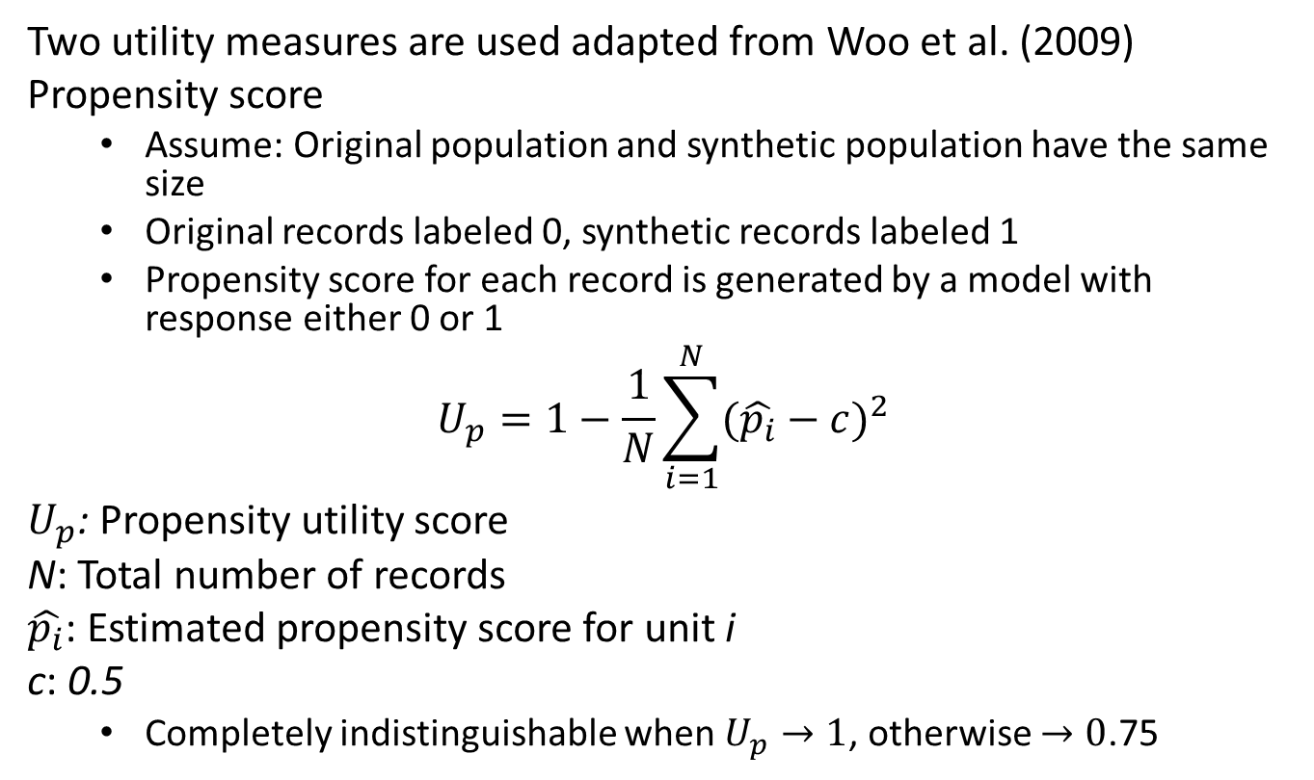
Two utility measures
Two utility measures are used adapted from Woo et al. (2009)
Propensity score
Assume: Original population and synthetic population have the same size
Original records labeled 0, synthetic records labeled 1
Propensity score for each record is generated by a model with response either 0 or 1
$$U_{p}=1−\frac{1}{N}\sum_{i=1}^{N}{{(\hat{p_{i}}−c)}^{2}}$$
$U_{p}$: Propensity utility score
N: Total number of records
$\hat{p_{i}}$: Estimated propensity score for unit i
c: 0.5
Completely indistinguishable when $U_{p}→1$, otherwise $→0$.75

Slide 9
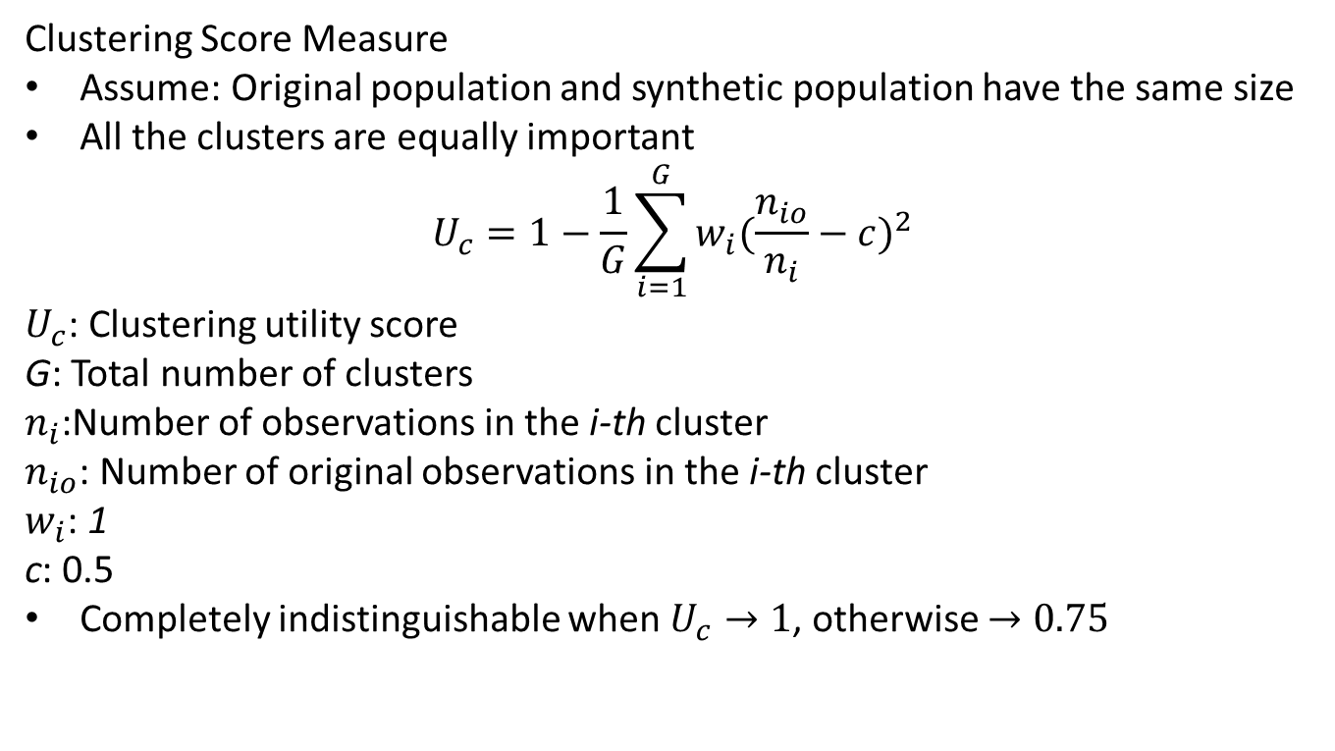
Two utility measures - continued
Clustering Score Measure
Assume: Original population and synthetic population have the same size
All the clusters are equally important
$$U_{c}=1−\frac{1}{G}\sum_{i=1}^{G}{{w_{i}(\frac{n_{io}}{n_{i}}−c)}^{2}}$$
$U_{c}$: Clustering utility score
G: Total number of clusters
$n_{i}$:Number of observations in the i-th cluster
$n_{io}$: Number of original observations in the i-th cluster
$w_{i}$: 1
c: 0.5
Completely indistinguishable when $U_{c}→1$, otherwise $→0.75$

Slide 10
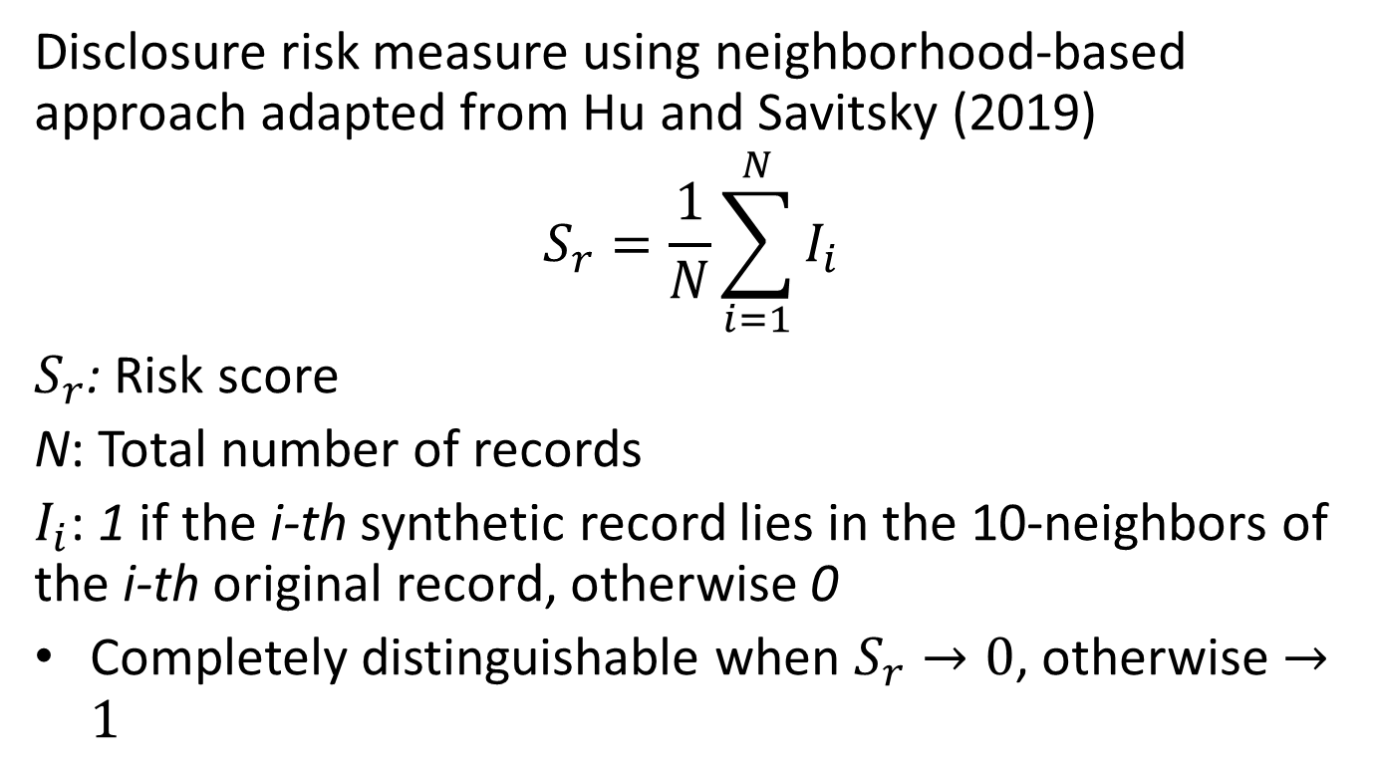
Evaluation of identification disclosure risk
Disclosure risk measure using neighborhood-based approach adapted from Hu and Savitsky (2019)
$$S_{r}=\frac{1}{N}\sum_{i=1}^{N}{I_{i}}$$
$S_{r}$: Risk score
N: Total number of records
$I_{i}$: 1 if the i-th synthetic record lies in the 10-neighbors of the i-th original record, otherwise 0
Completely distinguishable when $S_{r}→0$, otherwise $→1$

Slide 11
Pilot experiment
A subset of 2012 Census of Agriculture dataset
One million records
No missing values
A subset of items selected
Total Land in Farms
Total Value Production
State (State id)
County (County id)
Rescale to -1 and 1

Slide 12
Pilot experiment - continued
A GAN is trained on the subset of one million records dataset considering the loss function
In G-network
The cross entropy to penalize the output from G-network classified as synthetic by D-network
First, and second moments of the original distribution added to the loss function
In D-network
The cross entropy to penalize wrongly assigning the output from G-network to real, and real to synthetic
Utility measures are calculated to evaluate the synthetic population
Evaluation of identification disclosure risk measure is calculated

Slide 13
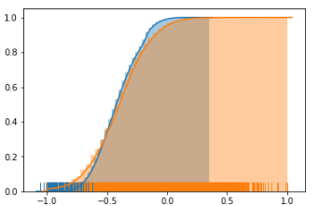
Result
Original Distribution
Total Land in Farms
Synthetic Distribution
Total Value Production

Slide 14
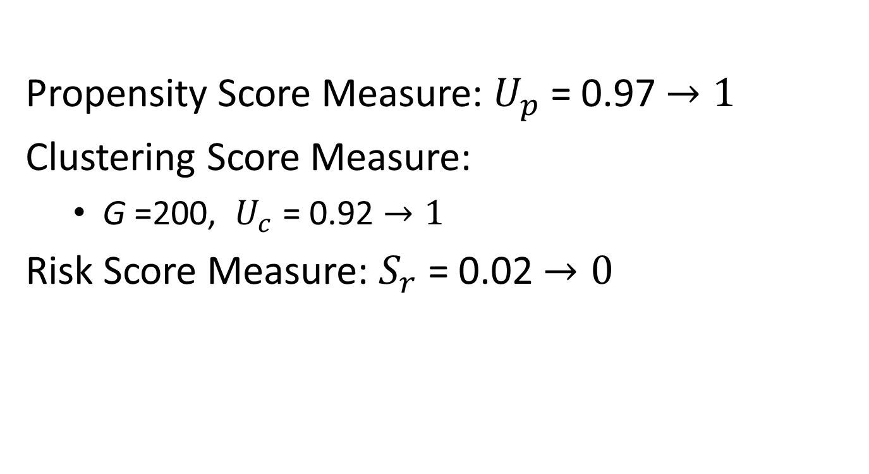
Result - continued
Propensity Score Measure: $U_{p}$ = 0.97 $→1$
Clustering Score Measure:
G =200, $U_{c}$ = 0.92 $→1$
Risk Score Measure: $S_{r}$ = 0.02 $→0$

Slide 15
Conclusion
GAN worked well for generating synthetic population for two continuous Census of Agriculture variables in terms of
Propensity score measure
Clustering score measure
GAN failed to capture extreme values
Identification disclosure risk of synthetic population is low

Slide 16
Future work
Comprehensive experimentation
Multiple variables
Different numbers of clusters
Categorical, count, and skewed variables
Further tuning of GAN’s hyper-parameters
Other measures of utility and of identification disclosure risks
Adaptation to better fit distribution extremes

Slide 17
Selected references
Goodfellow, I., Pouget-Abadie, J., Mirza, M., Xu, B., Warde-Farley, D., Ozair, S., ... & Bengio, Y. (2014). Generative adversarial nets. In Advances in neural information processing systems (pp. 2672-2680).
Hu, J., & Savitsky, T. D. (2018). Bayesian data synthesis and disclosure risk quantification: An application to the Consumer Expenditure Surveys. arXiv preprint arXiv:1809.10074.
Paiva, T., Chakraborty, A., Reiter, J. P., and Gelfand, A. E. (2014). Imputation of confidential data sets with spatial locations using disease mapping models. Statistics in Medicine 33, 1928–1945.
Reiter, J. P. (2005a). Estimating risks of identification disclosure in microdata. Journal of the American Statistical Association 100, 1103–1112.
Reiter, J. P. (2005b). Releasing multiply-imputed, synthetic public use microdata: An illustration and empirical study. Journal of the Royal Statistical Society, Series A 168, 185–205.

Slide 18
Selected references
Reiter, J. P. (2005c). Using cart to generate partially synthetic public use microdata. Journal of Official Statistics 21, 441–462.
Rubin, D. B. (1993). Discussion statistical disclosure limitation. Journal of Official Statistics 9, 461–468
Truta, T. M., Fotouhi, F., & Barth-Jones, D. (2003, July). Disclosure risk measures for microdata. In 15th International Conference on Scientific and Statistical Database Management, 2003. (pp. 15-22). IEEE.
Woo, M. J., Reiter, J. P., Oganian, A., & Karr, A. F. (2009). Global measures of data utility for microdata masked for disclosure limitation. Journal of Privacy and Confidentiality, 1(1).
Drechsler, J. and Reiter, J. P. (2009), Disclosure risk and data utility for partially synthetic data: An empirical study using the German IAB Establishment Survey, Journal of Official Statistics, 25, 589 - 603.

Slide 19
Questions?
ywei@niss.org

